Slide 1

BIOWARFARE - THE THREAT TO FUTURE

Slide 2
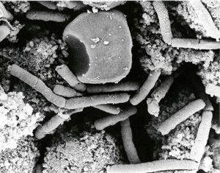
Biological Warfare
Biological warfare is the intentional use of microorganisms, and toxins to produce disease and death in humans, livestock and crops.
Biological weapons are defined as:
Microorganisms
Biologically Derived Bioactive Substances (BDBS)
Artificially Designed Biological-Mimicking Substances
Biological warfare is the intentional use of microorganisms, and toxins to produce disease and death in humans, livestock and crops.
Biological weapons are defined as:
Microorganisms
Biologically Derived Bioactive Substances (BDBS)
Artificially Designed Biological-Mimicking Substances

Slide 3

A pathogen can be obtained from two major sources:
Its natural environment
A microbiology laboratory or bank (ATCC)
Creating them

Slide 4
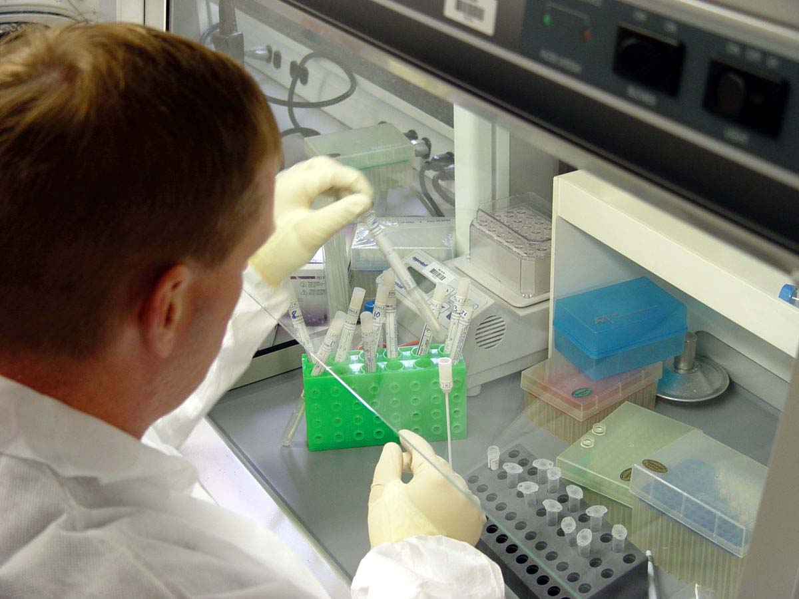
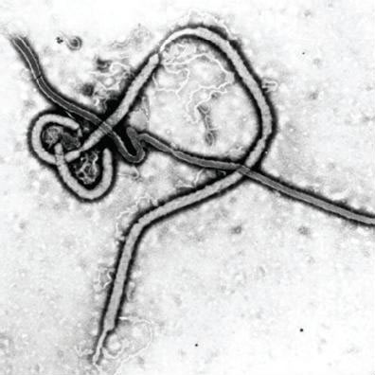
Types of biological agents
Categorized according to mortality rate.
Category A agents
- Anthrax, Botulinum, Smallpox, Ebola, Plague, Tularemia, Marburg etc.
Category B agents
- Q fever, Brucellosis, Typhus, Ricin etc.
Category C agents
- Nipah virus, Hantavirus, Multi-drug resistant Tuberculosis etc.

Slide 5
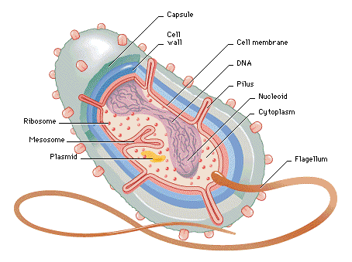
Bacterial source
Microorganisms that lack a nucleus and have a cell wall composed of peptidoglycan, a protein-sugar molecule.
Bacteria causes diseases like anthrax , plague etc..,

Slide 6
Types of Biological Weapons: Bacteria
Anthrax occurs naturally in cattle. It is normally transmitted to man through cuts on the arms and hands.
Plague or “black death” is transmitted to man from rats through the bite of infected fleas.
The bacteria can be air borne and be transmitted to man through the respiratory tract causing pneumonic plague (bleeding in lungs).
Untreated plague has a mortality rate of 90 -100%. It is a highly communicable biological warfare agent

Slide 7
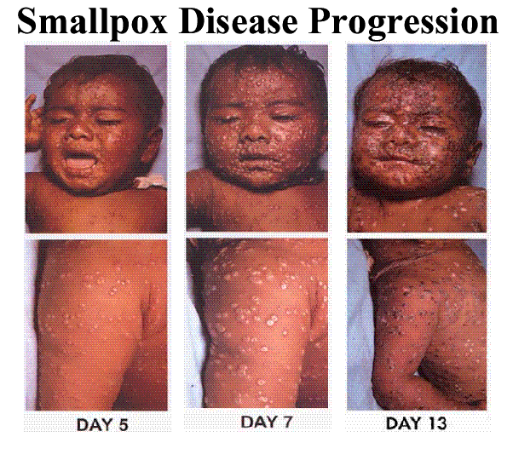
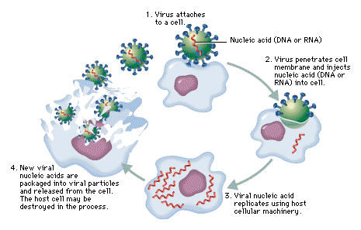
Viral sources.
A minute particle that lives as a parasite in plants, animals, bacteria and consists of a nucleic acid core within a protein sheath. Viruses can only replicate within living cells.
Venezuelan Equine Encephalitis
Small pox virus

Slide 8
Types of Biological Weapons: Viruses
Small pox is the only virus that has been eradicated from the earth. It exists only in laboratories.
The vaccine for smallpox is effective if given 2-4 days after exposure, but before illness.
VEE or Venezuelan Equine Encephalitis is an alpha virus that primarily affects horses. It is spread to humans via mosquito bites. Mortality from this virus is 5% and nearly all deaths occur in children or those with compromised immune systems.

Slide 9
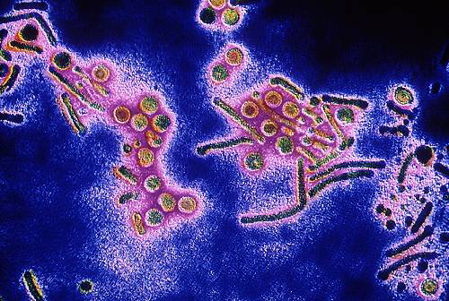
Toxin as source.
poisonous substance produced by the metabolic activities of certain living organisms.

Slide 10
Types of Biological Weapons: Toxins
1.Botulinum : found in soil, and enters body through digestive system and by inhalation.
2. Neurotoxins which attack the central nervous system.
3. Cytotoxins which are cell poisons.
4.Ricin :Ricin causes red blood cells to agglutinate (clump together) and burst by hemolysis (liberation of hemoglobin). normally enters the body by ingestion, enter by inhalation if in aerosolized form.

Slide 11
Delivery methods
Gas release and aerosol releases via airplanes, submarines, bombs, artillery and missiles
HCN missiles and central burster missiles.
Poisoned arrows, bullets, grenades, letters.
Food delivery: food, coffee, water, creams, juice
Blankets given in war to soldiers by rival soldiers.
Poisoning by adding M.O’s to water in specific area.

Slide 12
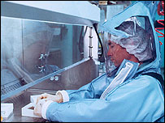
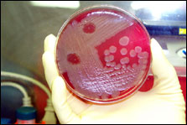
Characteristics of B.W
Highly infectious
Efficiently dispersible
Readily grown and produced in large quantities.
Stable in storage and Resistant environmental conditions.
Resistant to treatment

Slide 13
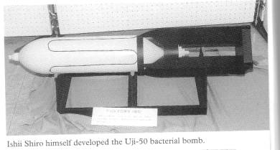
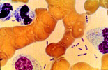
Chaos of B.W
Difficulty control and sufficient containment during growth and harvesting of agents.
Effective delivery problems.
Poor storage survival.
Difficult to control once released.
Difficulty of protecting the workers.

Slide 14
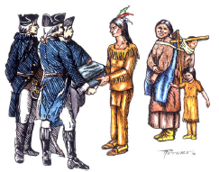

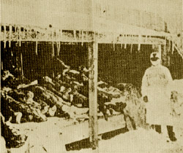
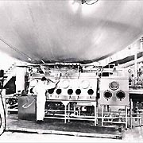
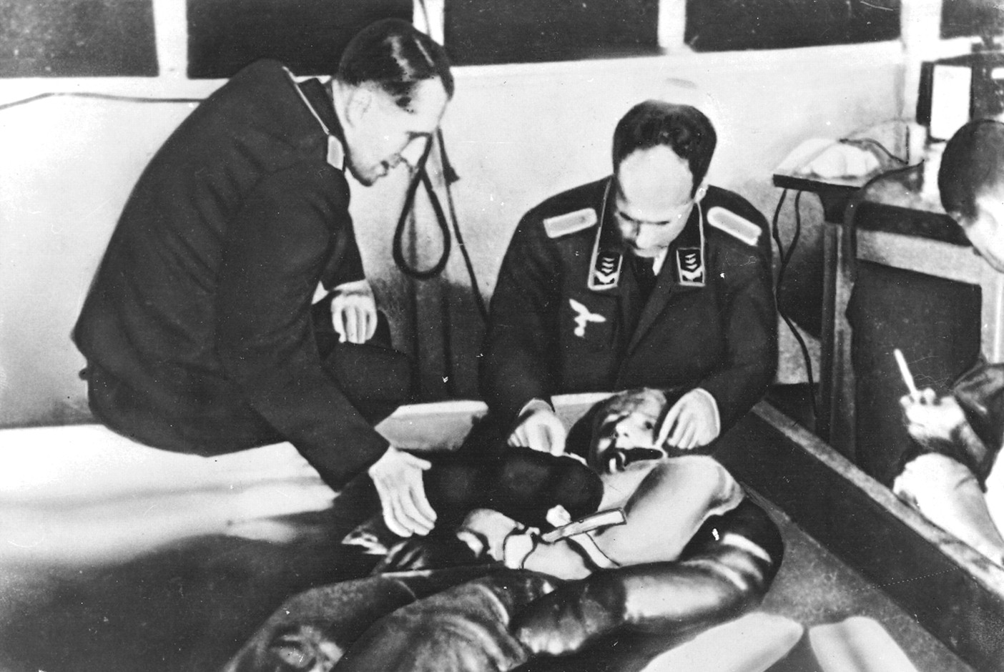
History
Scythian archers used poisoned arrows dipped in decayed bodies to kill and spread diseases.
French-Indian war : Sir Jeffery commanded to use blankets used by small pox patients to cause disease to the rivals.

Slide 15
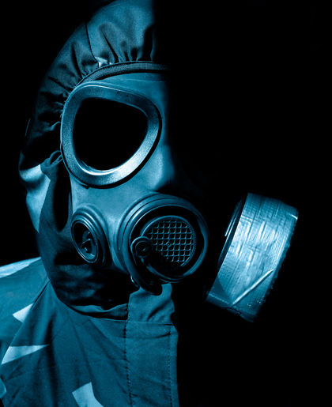
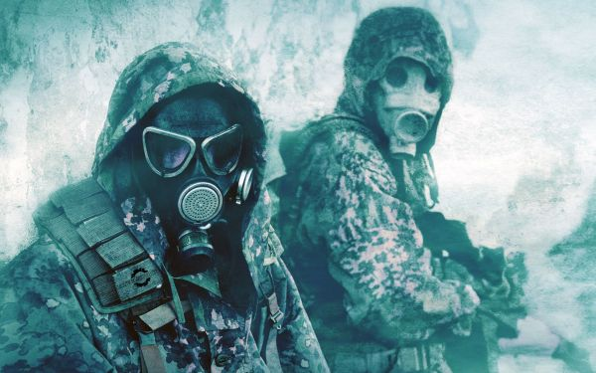
German army developed anthrax wheat fungus for use as bio weapons.
Japanese exposed more than 3000 victims to plague.
In 1943 British army also tested anthrax bombs on Gruinard island.

Slide 16
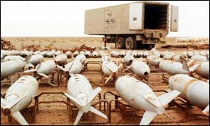
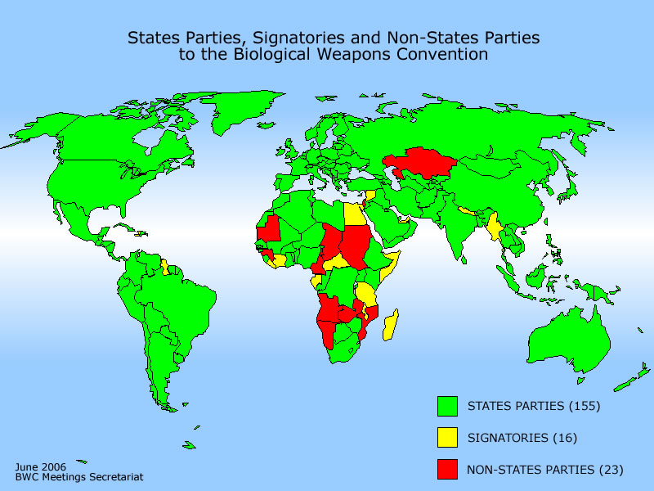
Protocols for banning b.w
Use of biological weapons was banned in international law by the Geneva Protocol of 1925.
The 1972 Biological and Toxin Weapons Convention extended the ban to almost all production, storage and transport of any types of biological weapons.

Slide 17

Bio-terrorism
There are number of bio-terrorism recently.
1984 Rajneeshee salmonella attack
-attempted to control a local election by infecting salad bars in 10 restaurants with Salmonella typhimurium in the small town of Oregon.
2001 anthrax attack
-Envelopes containing Anthrax spores was send deliberately to newspaper companies and US senators. and cause 5 Fatalities in 17 infections.

Slide 18
Prevention
: Initiation of immediate therapy and supportive care provides the best chance for survival from these potentially lethal and devastating infections. A high index of suspicion must be maintained, especially in the setting of a sudden influx of cases with what are often relatively nonspecific symptoms.
Development of rapid detection and Public education and awareness campaign.
Initiation of immediate therapy, supportive care provides the best chance for survival from these devastating infections.
A high index of suspicion must be maintained, in cases with what are often relatively nonspecific symptoms.

Slide 19
THANK YOU

